Slide 1

BLOCKCHAIN IN FOOD SUPPLY CHAIN
ANALYZING HOW BLOCKCHAIN ENHANCING TRANSPARENCY, TRACEABILITY AND TRUST IN THIS SECTOR

Slide 2
OBJECTIVES
Introduction to blockchain technology
Current food supply chain and issues
How blockchain can address these issues
Real-world applications and case studies
Future trends and implications strategies

Slide 3
INTRODUCTION TO BLOCKCHAIN TECHNOLOGY
Blockchain is a distributed ledger technology that securely records transactions across multiple computers in a way that is transparent, tamper-proof, and decentralized. It consists of blocks of data linked together cryptographically, forming a chronological chain. Decentralization Traditional databases, like those used by banks or companies, are centralized. In contrast, a blockchain is decentralized and distributed across a network of computers, known as nodes.
Once a transaction is added to the blockchain, it cannot be changed or deleted. This is ensured by cryptographic hash functions that link each block to the previous one, forming a chain. Transparency All transactions are transparent and can be traced back, while security is maintained through cryptographic techniques and consensus protocols.

Slide 4
CURRENT FOOD SUPPLY CHAIN
∙ Production - At this stage, the production of the food products is carried out by the farmers. At this production level, the food is grown, developed, or produced while adhering to quality and food safety standards.
Handling and Storage of Food Products - Before the food products are processed and packed, they undergo different activities of sorting, cleaning, grading, and storing the food under proper conditions. If the product is temperature-sensitive, it is stored under the right temperature to maintain its quality and freshness.
Processing and Packaging - At this stage, it is ensured to convert the food into an edible form. According to the product requirements, the process of cooking, cutting, baking, packaging, etc., is carried out. Here, the packaging team ensure that the food meets all the safety standards before packaging and is safe for consumption.
Distribution - After packaging, the food products are transported and distributed to suppliers and retailers.
Retailing - Here, the food products are delivered from suppliers to the consumers. At this stage, the products are displayed and sold at supermarkets, restaurants, online platforms, grocery stores, and many other places.
Consumption - This is the final stage of the food supply chain management. Here, the consumers make purchases of food products for consumption.

Slide 5
ISSUES IN CURRENT SUPPLY CHAIN
The supply chain management also deals with regular introductions of new products, to quality as well as safety requirements, uncertainty of high demands and manufacturing constraints that are highly complex, including food perishability factor. With steady growth in customers’ demands, ever-expanding product portfolios, and supply chains that are growing in length, there is an ardent need for inventory optimization.
Transparency- Lack of visibility into the supply chain processes
Traceability- Difficulty in tracking the origin and journey of products
Fraud and Contamination – Counterfeit products and adulterated ingredients
Inefficiencies- Delays and errors in documentation and transactions
Food safety and recalls- Challenges in managing recalls effectively and efficiently

Slide 6
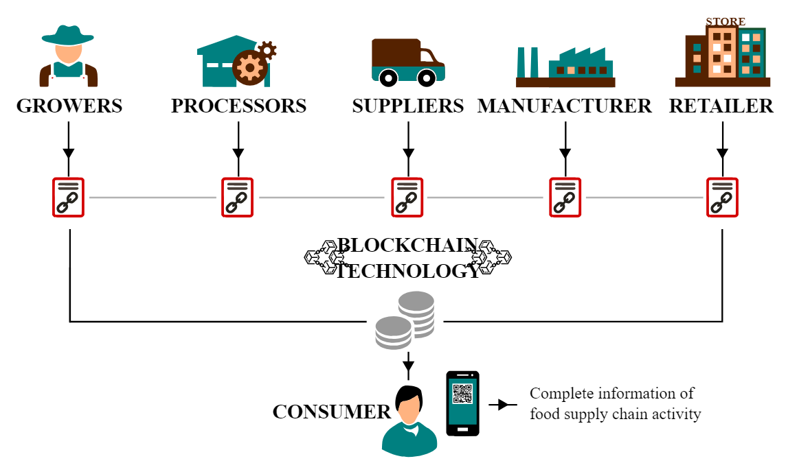
BLOCKCHAIN SOLUTION IN FOOD SUPPLY CHAIN Traceability-
Recording every step of the supply chain
Tracking every product from farm to store

Slide 7
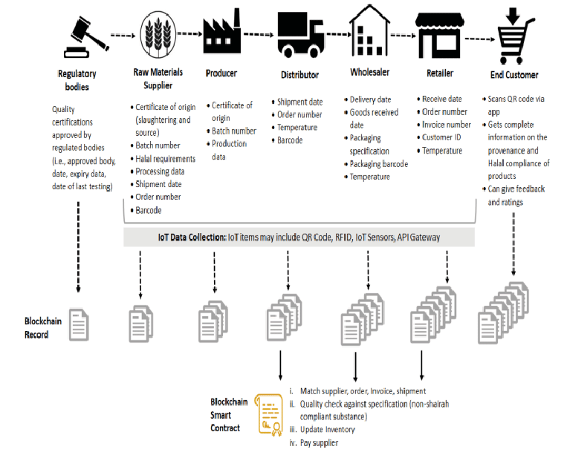

Slide 8
TRANSPARENCY AND TRUST
Building Transparency- Open and accessible data
Preventing data tampering and fraud
Consumer trust- providing consumers with verifiable information about product origin and handling.

Slide 9
EFFICIENCY AND COST REDUCTION
Improving Efficiency- Use of smart contracts to automate transactions. Reducing manual paperwork and administrative tasks.
Cost Savings – Lowering operational costs and reducing losses from food recalls and fraud.

Slide 10
Case Study 1 IBM Food Trust
IBM Food Trust - Collaboration with multiple food companies. Then had improved their Transparency and better supply chain coordination.
Key outcomes- Increased Efficiency and trust among participants

Slide 11
Case Study 2 WALMART
Walmart’s Blockchain Initiatives – Implementation for leafy greens. Walmart requires all trading suppliers of leafy-green vegetables to comply with data record i/p into a system blockchain platform traceback their product.
As a result they improved their safety measures and trace their product faster. Enhanced response to food safety incidents.

Slide 12
Case Study 3- Bumble Bee Seafoods
- Bumble Bee Seafoods transforming the industry through radical transparency. Bumble Bee Seafoods has been using blockchain technology to solve that where your fish comes from. The seafood manufacturer can now track each package of Natural Blue® by Anova ® yellowfin tuna back to the waters in which it was caught, providing full transparency to consumers of its journey to their plate. This move not only provides accountability to the consumer, it also marks a key shift in Bumble Bee’s potential use of large-scale data in its operations. Launched in March of 2019, Bumble Bee's traceability efforts through blockchain have continued to evolve and receive positive reviews from both retailers and consumers alike.
- Bumble Bee’s adoption of blockchain is not just an example of a large seafood company wanting to dispel doubt about its fishing practices — the move provides a window into quality and supply chain management, which in turn could unlock major savings for the company. While these upsides are still finding their way to its bottom line, Bumble Bee's use of blockchain is adding much-needed pressure to the food industry.
Blockchain technology allows companies such as Bumble Bee Foods to store data and create a tamper-proof supply chain history, which can be shared and seen by each participant. For Bumble Bee, blockchain is the safest possible way to share data between parties because it is incorruptible and verifiable. Bumble Bee is the first food company to incorporate SAP blockchain technology into its production.

Slide 13
BENEFITS FOR DIFFERENT STAKEHOLDERS
Farmers – Fair pricing reduced fraud
Distributors- Better inventory management
Retailers- Enhanced product recall capability
Consumers- Confidence in product safety and quality

Slide 14
Challenges and Limitations
Technological Barriers- Like Scalability issues and Interoperability with existing systems
Regulatory and legal Issues – Compliance with food safety regulations and Data privacy concerns.
Adoption Resistance- Hesitance from stakeholders to adopt new technology

Slide 15
Solution to Challenges
Regulatory compliance- Strategies for adhering to food safety standards and Ensuring data privacy and security .
Emerging solution – Layer 2 solution for Scalability and Consortium blockchains for better Interoperability.

Slide 16
Future Trends
Predictions for Blockchain in food supply chain – Increased Adoption and integration with IoT. Also Advances in blockchain technology foe better Scalability and efficiency.
Potential Innovations – Use of AI and m/c learning foe predictive analytics and greater collaboration among stakeholders.

Slide 17
Global Blockchain in Agriculture and Food Supply Chain Market Report
Blockchain in Agriculture and food supply chain is becoming increasingly important in the food and agriculture supply chain since it will increase transparency in producing food and agricultural products. Some of the main advantage of blockchain in agricultural and food supply chain that drive the market od supply chain include the requirements for affordable and accessible foods in times of calamities, performance measurement, the record of complete history of the product, fairer transfer of funds and customer satisfaction.
The agriculture and food supply chain’s blockchain is segmented by type, applications, organization size, product and provider. Based on type, the market is segmented as public and hybrid. The market is segmented by provider: application providers, middleware providers and infrastructure providers. By organization size, the market is segmented into small and medium-sized enterprises and large enterprises. By applications, the market is segmented as product traceability, tracking, visibility, payment and settlement.

Slide 18
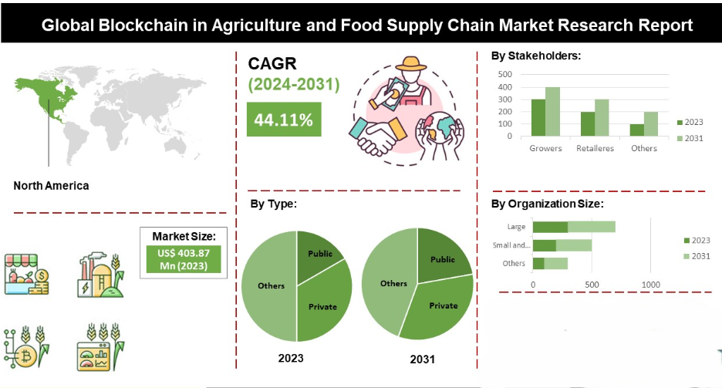
The north American blockchain in the agriculture and food supply chain market is expected to register the highest market share in revenue. IN may 2020 integrated blockchain technology into its supply chain traceability platform, offering players in the agriculture sector enhanced transparency of their products and assurance in the food safety.

Slide 19
Implementation Strategy
Assessing the current supply chain processes
Identifying key areas foe blockchain application
Developing a pilot project
Scaling up based on pilot results
Collaboration with all stakeholders
Continuous monitoring and improvement.

Slide 20
Potential Impacts
Economic Impact – Cost Savings , improved market efficiency
Environmental Impact – Reduction in food waste and better resource management
Social Impact – Enhanced food safety and increased consumer confidence

Slide 21

Conclusion
It is concluded that this blockchain technology is one of the most useful tools for traceability, timesaving, immutability, authentication and cost reduction. It had some challenges with lack of knowledge, Scalability and complexity in usage and that can be solved . It can be overcome by effective implementing create an awareness and training program for the employees. Blockchain technology can be used in various fields across India like Agri-food Supply chain management had a potential to transform into the next level of information distribution.

